Slide 1
Information extraction from unstructured text using structured data
Team: Tanay Chowdhury(tchowd4@uic.edu)
Vimalkumar Patel (vpatel84@uic.edu)
Guide: Iman Mirrezaei (smirre2@uic.edu)
Course: CS 586 Fall 2013
University of Illinois at Chicago

Slide 2
What: Unstructured Text to Structured Data
Wikipedia: collaborative free Internet encyclopedia.
Presence of a large body of unstructured content.
More than 4,366,570 English articles.
Content intermingled.
Info box
Text in article
Information out of reach from queriable semantic format
Can’t use SPARQL on Wikipedia text
Missing reuse of information between different articles

Slide 3
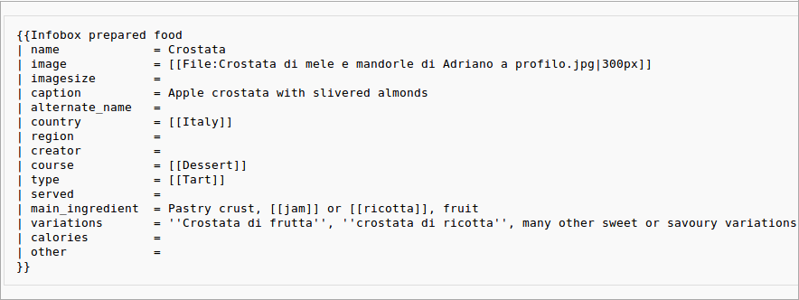
Wikipedia Infobox
An infobox is a template ,that is used to collect and present a subset of information about its subject.
It is a structured document containing a set of attribute–value pairs.
The name is delimited from the value by an equals sign.

Slide 4
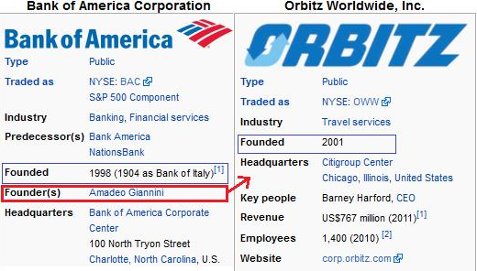
Missing Infobox property
As part of building master infobox template we have extracted infobox properties of some private organizations.
We found the missing infobox property of an organization with the help of training data.
For example Infobox of
Bank of America has the
value of founder but
Orbitz doesn’t have that.

Slide 5
Problem description
Existing works such as OLLIE generate ambiguous triples from unstructured text.
i.e. “Subject; Predicate; Object” → without mapping to actual IRI
We aim to disambiguate and extract missing properties.
We will use our novel string similarity based ontology matching program to obtain missing object value for property.
We will create turtle and enrich the data in triple store.

Slide 6
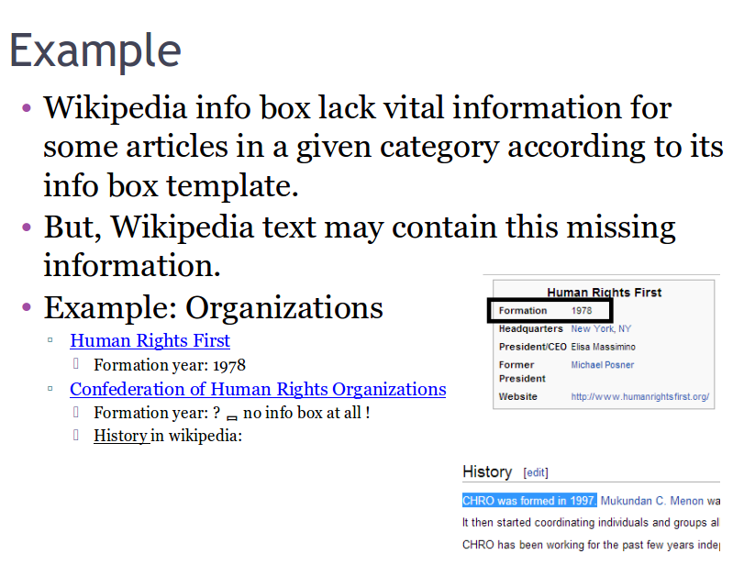

Slide 7
Approach
Wikipedia article
Unstructured text
Info Box
OLLIE
Reverb bootstrap
Context Analysis
Wikifi
Stanford NER
Novel program
Dbpedia lookup
RDF
URI for Subject, Object and Predicate
Triple Store

Slide 8
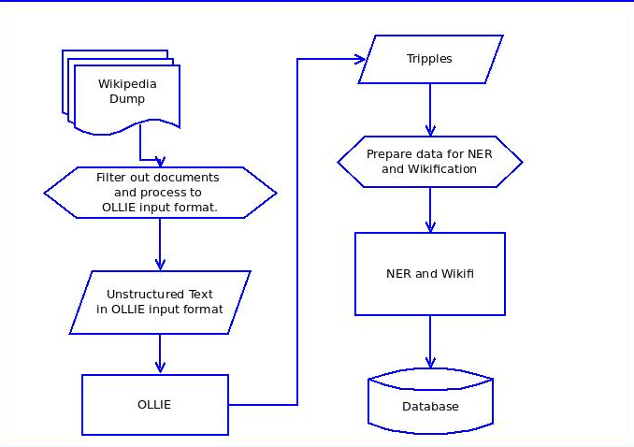
Process Flow : Generating Triple

Slide 9
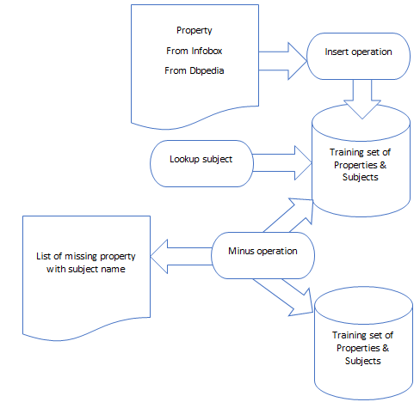
Prepare missing property list

Slide 10
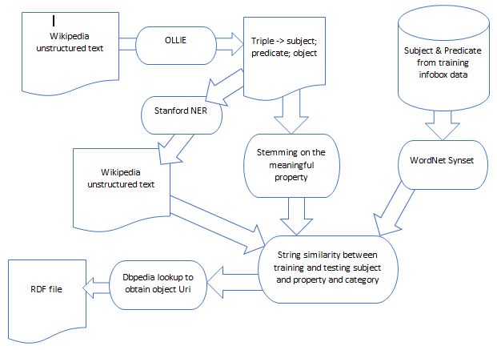
Ontology Matching for Object

Slide 11
Evaluation approach
Input: Wikipedia dump for private organization.
Prepare training data for some organizations.
Obtain missing property list from training data.
Run the process for the organization on its Wikipedia page for those missing properties.
Accuracy will be calculated based on number of correctly identified missing property.

Slide 12
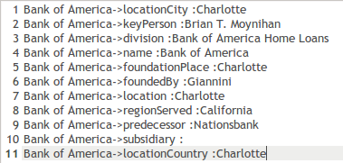
Result
We have used following list of properties to find their corresponding data.
We have given a mix of original and mock data to test this process

Slide 13
Result
Out of 11 properties we have tested we got expected correct result in 9 cases.
In one case the process didn’t identify the correct object Merrill Lynch for property subsidiary.
In one case the process has identified a city(Charlotte) as location country.
We have introduced wordsence based WuPalmer algorithm to correct this kind of location ambiguity.

Slide 14
Tools & Resources
Crawler
OLLIE
Dbpedia lookup
Jena
Jena-TDB
DBpedia Lookup
Wordnet (synonyms)

Slide 15
Why
Improvement:
Enriching & extending Wikipedia info box
Applicability:
Discover information outside info box.
Reuse of knowledge.
Future Work:
Finding related information that is not present in Wikipedia itself.
Eg: Bank of America stock price shows up in google search infobox but not in Wikipedia infobox.

Slide 16
Related work
LODifier: generating linked data from unstructured text.
RDF123 and Spotter: Tools for generating OWL and RDF for biodiversity data in spreadsheets and unstructured text
Similarity :We also create RDF(turtle) file from unstructured text and insert into triple store.
Dissimilarity: Unlike previous work we concentrated on missing properties and ontology matching for objects with novel algorithm in Wikipedia info box and take the help of Wikipedia unstructured text to map it.

Slide 17
References
@incollection{augenstein2012lodifier,
title={LODifier: generating linked data from unstructured text},
author={Augenstein, Isabelle and Pad{\'o}, Sebastian and Rudolph, Sebastian},
booktitle={The Semantic Web: Research and Applications},
pages={210--224},
year={2012},
publisher={Springer}
}
@inproceedings{ciravegna2012lodie,
title={LODIE: Linked Open Data for Web-scale Information Extraction.},
author={Ciravegna, Fabio and Gentile, Anna Lisa and Zhang, Ziqi}
}
@inproceedings{schmitz2012open,
title={Open language learning for information extraction},
author={Schmitz, Michael and Bart, Robert and Soderland, Stephen and Etzioni, Oren and others},
booktitle={Proceedings of the 2012 Joint Conference on Empirical Methods in Natural Language Processing and Computational Natural Language Learning},
pages={523--534},
year={2012},
organization={Association for Computational Linguistics}
}
@article{pierre2012entity,
title={Entity extraction: From unstructured text to DBpedia RDF triples},
author={Pierre, Nugues},
year={2012}
}

Slide 18
References
@article{pierre2012entity,
title={Entity extraction: From unstructured text to DBpedia RDF triples},
author={Pierre, Nugues},
year={2012}
}
@inproceedings{carroll2004jena,
title={Jena: implementing the semantic web recommendations},
author={Carroll, Jeremy J and Dickinson, Ian and Dollin, Chris and Reynolds, Dave and Seaborne, Andy and Wilkinson, Kevin},
booktitle={Proceedings of the 13th international World Wide Web conference on Alternate track papers \& posters},
pages={74--83},
year={2004},
organization={ACM}
}
@inproceedings{wu2008automatically,
title={Automatically refining the wikipedia infobox ontology},
author={Wu, Fei and Weld, Daniel S},
booktitle={Proceedings of the 17th international conference on World Wide Web},
pages={635--644},
year={2008},
organization={ACM}
}

